Slide 1
Introduction
Name: Dewan Muhammad Eshtiak
School: Saturia Pilot Girls Hish School
Position: Assistant English teacher
District: Manikganj
Class 7
English Grammer

Slide 2
Learning outcomes
After completing this lesson student will be able to-
Use present continuous tense and its structure
Make sentences by following the structure
Develop speaking skill by Answering question using present continuous tense
Identify the differences between present participle and present continuous tense
Make assertive continues to interrogative continues tense

Slide 3



Slide 4
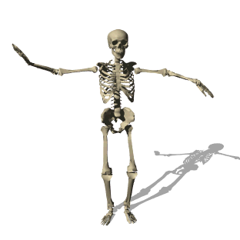




Slide 5
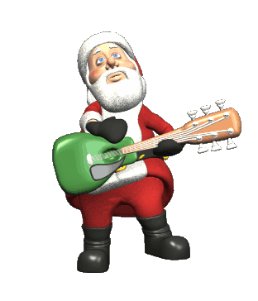
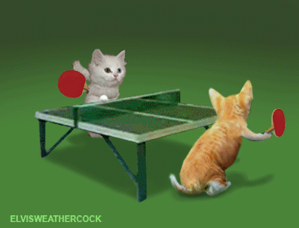

Slide 6

Present continuous tense

Slide 7
Structure: Sub + be verb+ verb + ing + adjunct
Man
Is running
fast

Slide 8
Sub+ be verb+ verb+ing + adjunct
They
are
swimming
slowly

Slide 9
Group work
Make five sentences using present continues tense structure.
Dance
Play
Walk
Eat
watch

Slide 10


I love playing foot ball
I am eating bread

Slide 11

It is running fast
I like singing too
Sub + verb + (naming word+ ing)+ adjunct

Slide 12
Individual work
Write two sentence using present participle structure
Sub + verb + (naming word+ ing)+ adjunct

Slide 13
Giraffes
are
Dancing
?
Sub +
Be verb +
Verb + ing
?

Slide 14
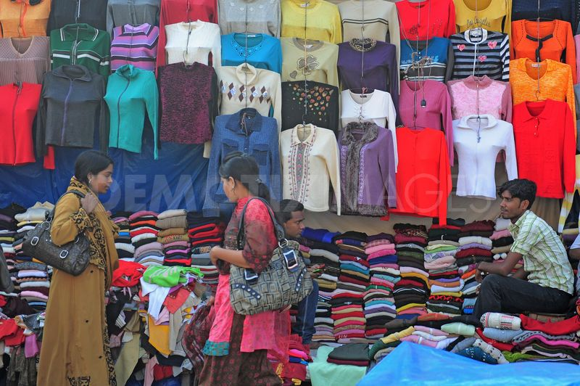
Pair work
Converse each other about ‘market’ using the given words:
go, choose, buy, pay and come

Slide 15

Home work
Make three sentences using present continues structure, based on your personal experience from your surrounding environment .

Slide 16

Thank you so much

